Slide 1

Programming 6G4Z0020
Web 1B : Code-a-long
Variables
Notes:
Dr David McLean – lecturer and researcher (google scholar) and programming for a long time – professionally and as an academic

Slide 2
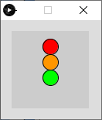
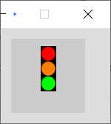
Exercise : traffic lights
Draw this ?
Design?
Improve it
Notes:
Walk through design : x,y,diameter

Slide 3
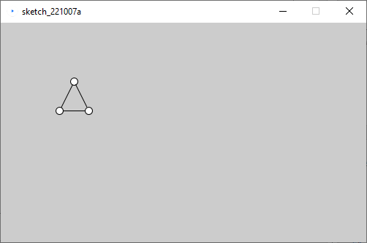
Exercise
Write a program to draw this shape, using x,y variables
Design?
First question : what should x,y represent?
Notes:
Do together – walk through design

Slide 4
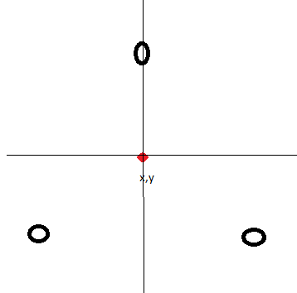
Design Help

Slide 5
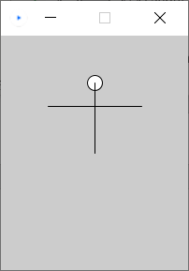
Debug
Code should produce image but isn’t working??
int x,y size;
x=100;
y=75
size=50;
size(200,250);
ellipse(x,y-size/2, size/3);
line(x-size,y, X+20,y);
line(x,y-size/2, x,y+50);

